Slide 1
Welspun Group | Name of Business
Highlights of Achievements in the year 2014-15
By: Ruchee Trivedi

Slide 2
“Environment” Activities & Impacts…
Plantation:
A innovative concept of “Kitchen Garden” - “Recycle of water”, “Produce Healthy Food in own Home” & “Save the Money & Health of community people”
Total 500 plants of fruits & flowers, 60 packets of seeds of different Vegetables planted to the villages & at present 100% plants are in growing stage.
Pure & Safe Drinking Water facility for community:
Total 3 RO plants donated to village Varshamedi, Khara Pawaria & Ajapar.
Varshamedi –
Approx 5000 people getting benefits of pure & Safe drinking water in their village at token charges (Rs. 5/- for 20 ltrs.) so Poor & Middle class people can also afford.
Pure water can avoid maximum diseases. It is helpful for community health.
2 RO plants are ready for installation.

Slide 3
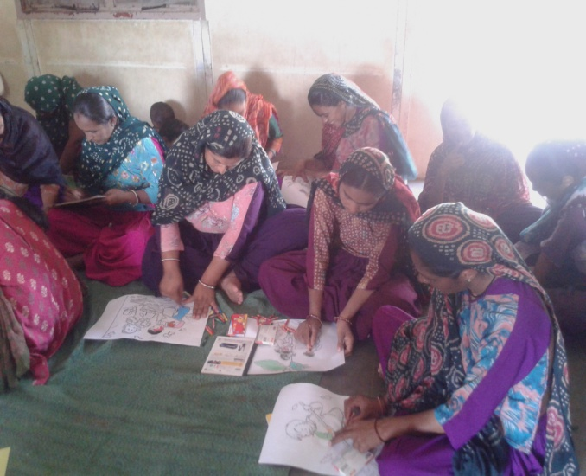
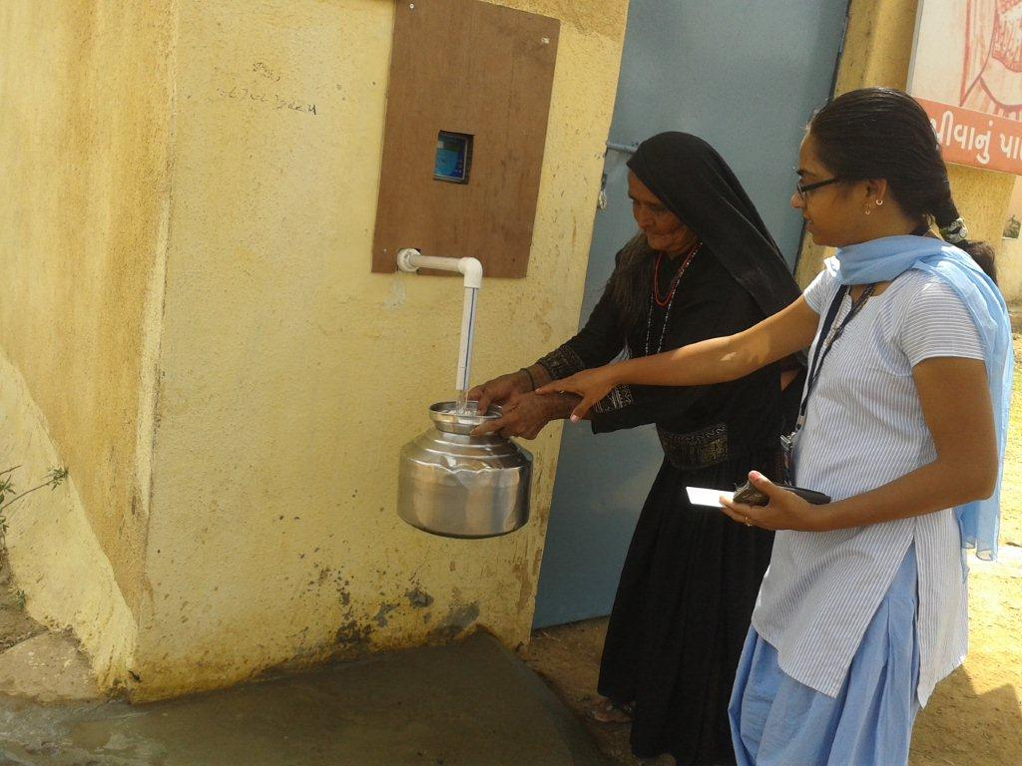
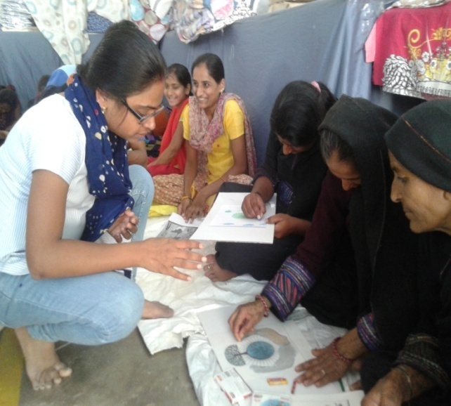
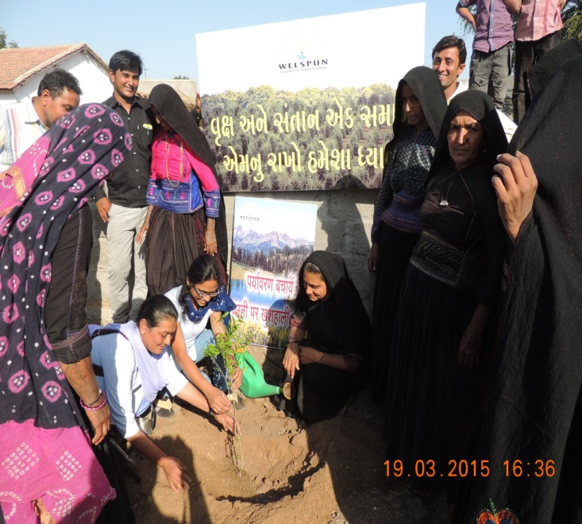
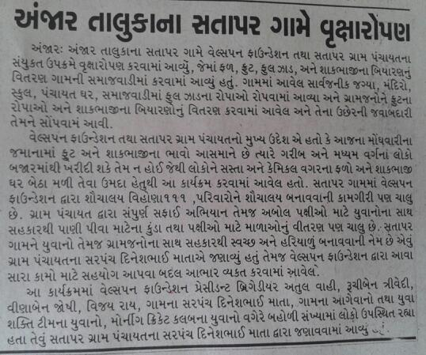
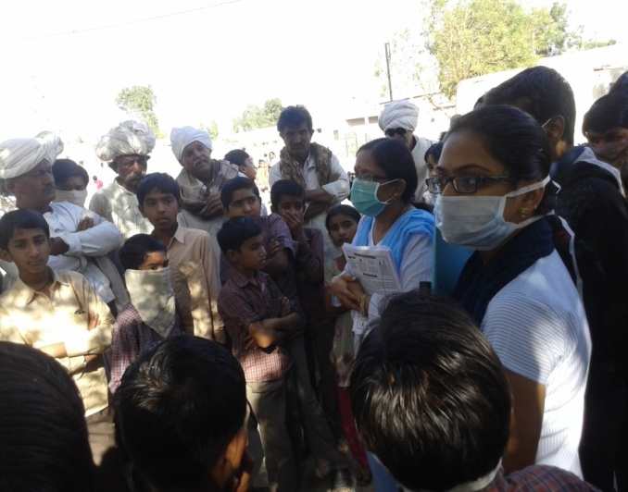
Awareness Campaigns……

Slide 4
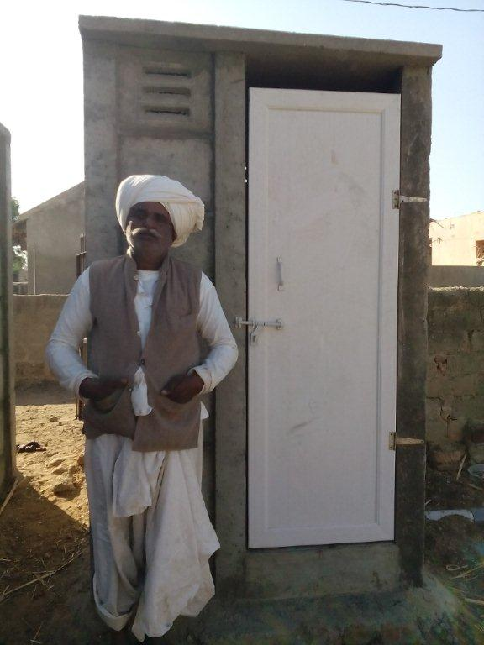
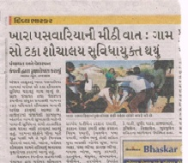
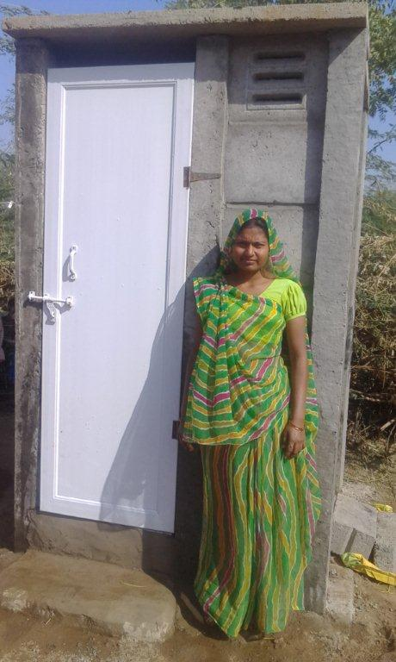
“Environment” Activities & Impacts…
Sanitation : Toilet Construction project:
Total 850 toilets prepared & handed over to villagers against the target of 1060 in 9 villages, these 9 villages become 100% pure. Average 85% families (approx 5000 people) are using the facility; they are satisfied with the facility.
Task was completed within a very short time period within - 1 and half month (15th Feb, 2015 to 31st march, 2015) Community has a safe environment in village.

Slide 5
Village wise Toilet construction report:
Sr. No. | Name of Village | Total No. of Toilet Targeted | No. of Toilets Completed | No. of Toilets under Progress | Remarks
1 | Varshamedi | 75 | 75 | 0 | Completed
2 | Khara Paswaria | 183 | 183 | 0
3 | Ajapar | 102 | 102 | 0
4 | Modvadar | 130 | 130 | 0
5 | Ratnal | 300 | 230 | 70 | 200 completed
6 | Khambhara | 30 | 0 | 30 | Under progress
7 | Sinugra | 29 | 29 | 0 | Last stage in completion
8 | Dudhai | 100 | 100 | 0
9 | Satapar | 130 | 130 | 0
 | Total | 1079 | 979 | 100

Slide 6
“Empowerment” Specific Projects done Under Women
Self Help Group (SHGs) formation through Govt. linkages:
100% women of all CSR centre have been covered through 10 Self Help Groups (120 women) have been formatted & with the linkages with Gujarat Government’s “Mission Mangalam Scheme”. These women will get all the benefits as per the Government rules & regulations.
Insurance coverage:
100% women of all CSR centre are covered with WC insurance policy.

Slide 7
Thank You !!

